Slide 1
Artificial Neural Network

Slide 2
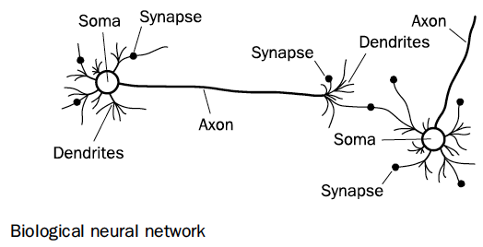
Neuron in the Brain
Sumber: MICHAEL NEGNEVITSKY, Artificial Intelligence : A Guide to Intelligent Systems, Second Edition, Addision Wesley, 2005
A neuron consists of a cell body, soma, a number of fibres called dendrites, and a single long fibre called the axon.
While dendrites branch into a network around the soma, the axon stretches out to the dendrites and somas of other neurons.

Slide 3
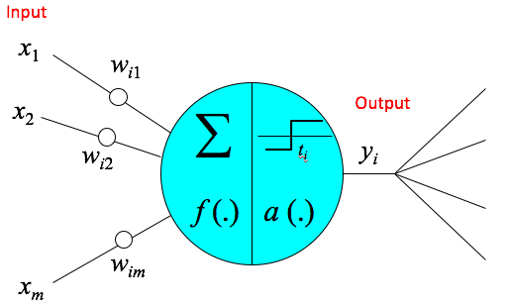
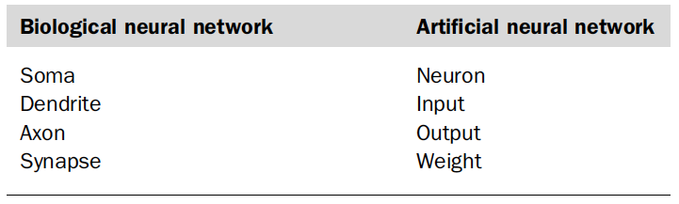
The Artificial Neurons
Sumber: MICHAEL NEGNEVITSKY, Artificial Intelligence : A Guide to Intelligent Systems, Second Edition, Addision Wesley, 2005

Slide 4
The Artificial Neurons
w_{ij}
positive — excitatory
negative — inhibitory
zero — no connection
t_{i} — threshold
Proposed by McCulloch and Pitts [1943]
called M-P neurons
x₁
w_{i1}
x₂
∑
w_{i2}
t_{i}
y_{i}
f (.)
a (.)
w_{im}
x_{m}

Slide 5
Neuron
The neuron is the basic information processing unit of a Neural Network. It consists of:
A set of links, describing the neuron inputs, with weights w₁, w₂, …, w_{m}
An adder function (linear combiner) for computing the weighted sum of the inputs:
(real numbers)
Activation function a(.) for limiting the amplitude of the neuron output.

Slide 6
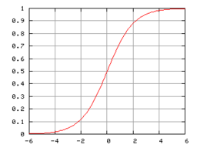
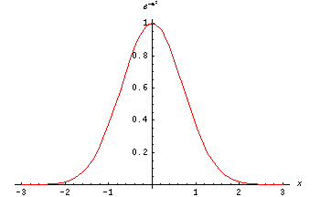
Activation Function a(.)
Step function
Sigmoid function
Gaussian function

Slide 7
What Can a Neuron Do?
A hard limiter.
A binary threshold unit.
Hyperspace separation.
y
0
x₂
w₁ x₁ + w₂ x₂ = t
t
1
∑
x₁
w₁
w₂
x₁
x₂

Slide 8
Artificial Neural Networks (ANN)
Output Y is 1 if at least two of the three inputs are equal to 1.

Slide 9
Artificial Neural Networks (ANN)

Slide 10
Algorithm for learning ANN
Initialize the weights (w₀, w₁, …, w_{k})
Adjust the weights in such a way that the output of ANN is consistent with class labels of training examples
Objective function:
Find the weights w_{i}’s that minimize the above objective function
e.g., backpropagation algorithm

Slide 11
Learning Algorithms
To design a learning algorithm, we face the following problems:
Whether to stop?
In what direction to proceed?
How long a step to take?
Is the criterion satisfactory?
e.g., gradient descent
α: learning rate

Slide 12
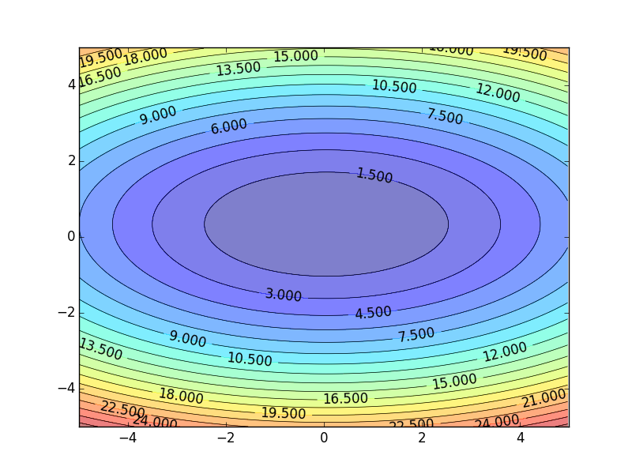

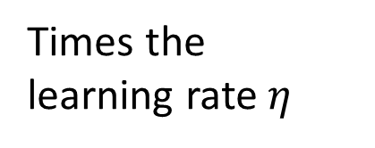

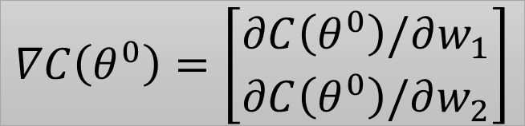





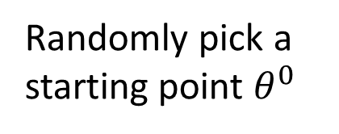
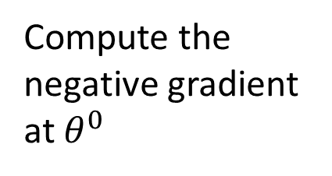


Gradient Descent
Assume there are only two parameters w₁ and w₂ in a network.
Error Surface
$$θ=\left\{w_{1},w_{2}\right\}$$
The colors represent the value of C.
Randomly pick a starting point $θ^{0}$
Compute the negative gradient at $θ^{0}$
$$w_{2}$$
$$θ^{∗}$$
$$−η∇C\left(θ^{0}\right)$$
$$−∇C\left(θ^{0}\right)$$
$$−∇C\left(θ^{0}\right)$$
Times the learning rate $η$
$$∇C\left(θ^{0}\right)=\left[\begin{matrix}∂C\left(θ^{0}\right)/∂w_{1} \\ ∂C\left(θ^{0}\right)/∂w_{2}\end{matrix}\right]$$
$$θ^{0}$$
$$−η∇C\left(θ^{0}\right)$$
$$w_{1}$$
Source: Hung-yi Lee, Deep Learning Tutorial
Notes:
Eta
人站在 ｔｈｅｔａ０ 環顧四周 看看哪裡最低，那個方向就是 ｇｒａｄｉｅｎｔ

Slide 13






Gradient Descent
Eventually, we would reach a minima …..
Randomly pick a starting point $θ^{0}$
Compute the negative gradient at $θ^{0}$
$$θ^{2}$$
$$−η∇C\left(θ^{2}\right)$$
$$−η∇C\left(θ^{1}\right)$$
$$w_{2}$$
$$−∇C\left(θ^{2}\right)$$
$$−∇C\left(θ^{1}\right)$$
$$θ^{1}$$
$$−∇C\left(θ^{0}\right)$$
Times the learning rate $η$
$$θ^{0}$$
$$−η∇C\left(θ^{0}\right)$$
$$w_{1}$$
Source: Hung-yi Lee, Deep Learning Tutorial

Slide 14
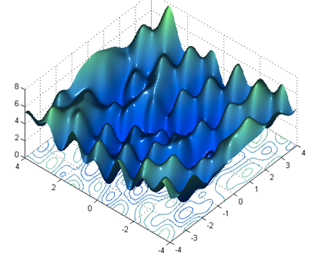



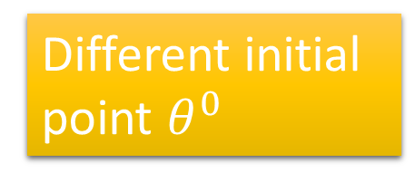
Local Minima
Gradient descent never guarantee global minima
Different initial point $θ^{0}$
Reach different minima, so different results
$$C$$
Who is Afraid of Non-Convex Loss Functions?
http://videolectures.net/eml07_lecun_wia/
$$w_{1}$$
$$w_{2}$$
Source: Hung-yi Lee, Deep Learning Tutorial

Slide 15



Besides local minima ……
cost
Very slow at the plateau
Stuck at saddle point
Stuck at local minima
$$∇C\left(θ\right)≈0$$
$$∇C\left(θ\right)=0$$
$$∇C\left(θ\right)=0$$
parameter space
Source: Hung-yi Lee, Deep Learning Tutorial

Slide 16
Back propagation algorithm for Single-Layer Perceptron
Step 0 - Initialize weights (w₀, w₁, …, w_{n}), m = 0, learning rate η, and threshold t
Step 1 – Do m = m + 1
Step 2 – Select pattern X^{m}
Step 3 – Calculate output
Step 3 – Calculate error atau delta δ = d – o
Step 4 – Update weight
Step 5 – Repeat until w convergent
Step 6 – Return w

Slide 17
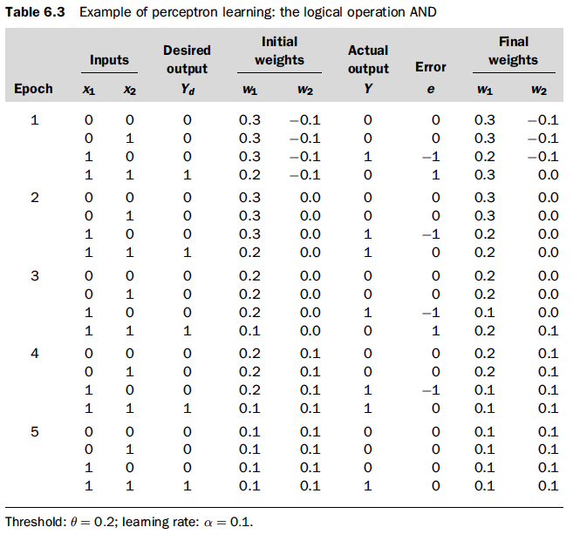
Sumber: MICHAEL NEGNEVITSKY, Artificial Intelligence : A Guide to Intelligent Systems, Second Edition, Addision Wesley, 2005

Slide 18
General Structure of ANN
Training ANN means learning the weights of the neurons

Slide 19
Multilayer Perceptron
y₁
y₂
y_{n}
Output Layer
. . .
Hidden Layer
. . .
. . .
Input Layer
. . .
x₁
x₂
x_{m}

Slide 20
How an MLP Works?
Example:
Not linearly separable.
Is a single layer perceptron workable?
XOR
x₂
1
0
x₁
1

Slide 21
How an MLP Works?
Example:
XOR
L₁
00
y₁
y₂
L₂
x₂
01
L₁
L₂
1
11
x₁
x₂
x₃= −1
0
x₁
1

Slide 22
How an MLP Works?
Example:
XOR
L₁
L₃
00
L₂
x₂
01
y₂
1
1
11
0
x₁
0
y₁
1
1

Slide 23
How an MLP Works?
Example:
XOR
L₁
L₃
00
L₂
x₂
01
y₂
1
1
11
0
x₁
0
y₁
1
1

Slide 24
How an MLP Works?
Example:
z
L₃
L₃
y₂
y₁
y₂
1
L₁
L₂
y₃= −1
0
y₁
x₁
x₂
x₃= −1
1

Slide 25
Parity Problem
Is the problem linearly separable?
x₁ x₂ x₃
x₃
000
0
001
1
010
1
011
0
100
1
x₂
101
0
110
0
111
1
x₁

Slide 26
Parity Problem
x₁ x₂ x₃
x₃
000
0
001
1
P₁
010
1
011
0
100
1
P₂
P₃
x₂
101
0
110
0
111
1
x₁

Slide 27
Parity Problem
x₁ x₂ x₃
x₃
000
0
001
1
P₁
010
1
111
011
0
100
1
P₂
P₃
x₂
101
0
011
110
0
111
1
x₁
000
001

Slide 28
Parity Problem
x₃
P₁
y₁
y₂
y₃
111
P₁
P₂
P₃
P₂
P₃
x₂
011
x₁
x₂
x₃
x₁
000
001

Slide 29
Parity Problem
y₃
x₃
P₁
111
P₄
y₂
P₂
P₃
x₂
011
y₁
x₁
000
001

Slide 30
Parity Problem
z
y₃
P₄
y₁
y₃
y₂
P₄
P₁
P₂
P₃
y₂
y₁
x₁
x₂
x₃

Slide 31
General Problem

Slide 32
General Problem

Slide 33
Hyperspace Partition
L₃
L₁
L₂

Slide 34
Region Encoding
000
001
L₃
L₁
010
100
101
110
111
L₂

Slide 35
Hyperspace Partition & Region Encoding Layer
000
L₃
001
L₁
L₁
L₂
L₃
010
100
101
x₁
110
x₂
x₃
111
L₂

Slide 36
Region Identification Layer
101
000
L₃
001
L₁
L₁
L₂
L₃
010
100
101
x₁
110
x₂
x₃
111
L₂

Slide 37
Region Identification Layer
001
000
L₃
001
L₁
L₁
L₂
L₃
010
100
101
x₁
110
x₂
x₃
111
L₂

Slide 38
Region Identification Layer
000
000
L₃
001
L₁
L₁
L₂
L₃
010
100
101
x₁
110
x₂
x₃
111
L₂

Slide 39
Region Identification Layer
110
000
L₃
001
L₁
L₁
L₂
L₃
010
100
101
x₁
110
x₂
x₃
111
L₂

Slide 40
Region Identification Layer
010
000
L₃
001
L₁
L₁
L₂
L₃
010
100
101
x₁
110
x₂
x₃
111
L₂

Slide 41
Region Identification Layer
100
000
L₃
001
L₁
L₁
L₂
L₃
010
100
101
x₁
110
x₂
x₃
111
L₂

Slide 42
Region Identification Layer
111
000
L₃
001
L₁
L₁
L₂
L₃
010
100
101
x₁
110
x₂
x₃
111
L₂

Slide 43
Classification
0
0
−1
1
1
101
101
001
001
000
110
010
100
111
000
L₃
001
L₁
L₁
L₂
L₃
010
100
101
x₁
110
x₂
x₃
111
L₂

Slide 44
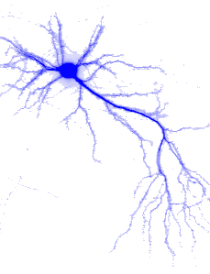
Feed-Forward Neural Networks
Back Propagation Learning algorithm

Slide 45
Supervised Learning
Training Set
o₁
o₂
o_{n}
d₁
d₂
d_{n}
Output Layer
. . .
Hidden Layer
. . .
. . .
Input Layer
. . .
x₁
x₂
x_{m}

Slide 46
Supervised Learning
Training Set
Sum of Squared Errors
o₁
o₂
o_{n}
d₁
d₂
d_{n}
. . .
. . .
Goal:
. . .
Minimize
. . .
x₁
x₂
x_{m}

Slide 47
Back Propagation Learning Algorithm
o₁
o₂
o_{n}
d₁
d₂
d_{n}
Learning on Output Neurons
Learning on Hidden Neurons
. . .
. . .
. . .
. . .
x₁
x₂
x_{m}

Slide 48
Learning on Output Neurons
o₁
o_{j}
o_{n}
d₁
d_{j}
d_{n}
. . .
j
. . .
w_{ji}
. . .
i
. . .
. . .
. . .
?
?
. . .
. . .

Slide 49
Learning on Output Neurons
o₁
o_{j}
o_{n}
d₁
d_{j}
d_{n}
. . .
j
. . .
w_{ji}
. . .
i
. . .
. . .
. . .
. . .
. . .
depends on the activation function

Slide 50
Activation Function — Sigmoid
1
0.5
net
0
Remember this

Slide 51
Learning on Output Neurons
o₁
o_{j}
o_{n}
d₁
d_{j}
d_{n}
. . .
j
. . .
w_{ji}
. . .
i
. . .
. . .
. . .
. . .
. . .
Using sigmoid,

Slide 52
Learning on Output Neurons
o₁
o_{j}
o_{n}
d₁
d_{j}
d_{n}
. . .
j
. . .
w_{ji}
. . .
i
. . .
. . .
. . .
. . .
. . .
Using sigmoid,

Slide 53
Learning on Output Neurons
o₁
o_{j}
o_{n}
d₁
d_{j}
d_{n}
. . .
j
. . .
w_{ji}
. . .
i
. . .
. . .
. . .
. . .
. . .

Slide 54
Learning on Output Neurons
o₁
o_{j}
o_{n}
d₁
d_{j}
d_{n}
. . .
j
. . .
How to train the weights connecting to output neurons?
w_{ji}
. . .
i
. . .
. . .
. . .
. . .
. . .

Slide 55
Learning on Hidden Neurons
. . .
j
. . .
w_{ji}
. . .
i
. . .
?
?
w_{ik}
. . .
k
. . .
. . .
. . .

Slide 56
Learning on Hidden Neurons
. . .
j
. . .
w_{ji}
. . .
i
. . .
w_{ik}
. . .
k
. . .
. . .
. . .

Slide 57
Learning on Hidden Neurons
. . .
j
. . .
w_{ji}
. . .
i
. . .
w_{ik}
. . .
k
. . .
?
. . .
. . .

Slide 58
Learning on Hidden Neurons
. . .
j
. . .
w_{ji}
. . .
i
. . .
w_{ik}
. . .
k
. . .
. . .
. . .

Slide 59
Learning on Hidden Neurons
. . .
j
. . .
w_{ji}
. . .
i
. . .
w_{ik}
. . .
k
. . .
. . .
. . .

Slide 60
Back Propagation
o₁
o_{j}
o_{n}
d₁
d_{j}
d_{n}
. . .
j
. . .
. . .
i
. . .
. . .
k
. . .
. . .
. . .
x₁
. . .
x_{m}

Slide 61
Back Propagation
o₁
o_{j}
o_{n}
d₁
d_{j}
d_{n}
. . .
j
. . .
. . .
i
. . .
. . .
k
. . .
. . .
. . .
x₁
. . .
x_{m}

Slide 62
Back Propagation
o₁
o_{j}
o_{n}
d₁
d_{j}
d_{n}
. . .
j
. . .
. . .
i
. . .
. . .
k
. . .
. . .
. . .
x₁
. . .
x_{m}

Slide 63

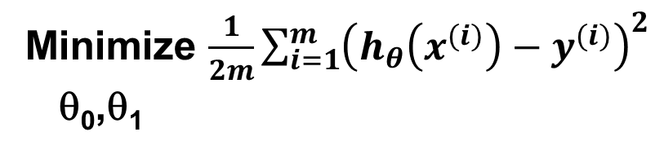
Multilayer Neural Network
x_{i}
$$δ_{j}={λo}_{j} \left(1−o_{j}\right)\sum{w_{ji}}δ_{k}$$
x_{i}
w_{ji}
$$δ_{k}=(d_{k}−o_{k}){o}_{k}(1−o_{k})$$
w_{kj}

Slide 64
Backpropagation algorithm for MultiLayer Perceptorn
Step 0 - Initialize weights (w₀, w₁, …, w_{n}), m = 0, learning rate η, and threshold t, sigmoid variable λ
Step 1 – Do m = m + 1
Step 2 – Select pattern X^{m}
Step 3 – Calculate output o_{j} and o_{k}
Step 3 – Calculate delta δ_{k} and δ_{j}
Step 4 – Update weight
Step 5 – Repeat until w convergent
Step 6 – Return w

Slide 65
https://machinelearningmastery.com/implement-backpropagation-algorithm-scratch-python/

Slide 66
Learning Factors
Initial Weights
Learning Rate (η)
Cost Functions
Momentum
Update Rules
Training Data and Generalization
Number of Layers
Number of Hidden Nodes

Slide 67
Number of Hidden Layers
In fact, for many practical problems, there is no reason to use more than one hidden layer.
No. of Hidden Layer | Result
none | Only capable for representing linear separable function or decision
1 | Can approximate any function that contains a continuous mapping from one finite space to another
2 | Can represent an arbitrary decision boundary to arbitrary accuracy with rational activation functions and can approximate any smooth mapping to any accuracy

Slide 68
Number of Neurons in the Hidden Layer
There are many rule-of-thumb methods:
Between the size of the input layer and the size of output layer
2/3 the size of the input layer, plus the size of the output layer
Less than twice the size of the input layer

Slide 69
Number of Neurons in Output Layer
Regression
One neuron
Classification
Binary class ➔ one neuron
Multi class ➔ more than one neuron

Slide 70
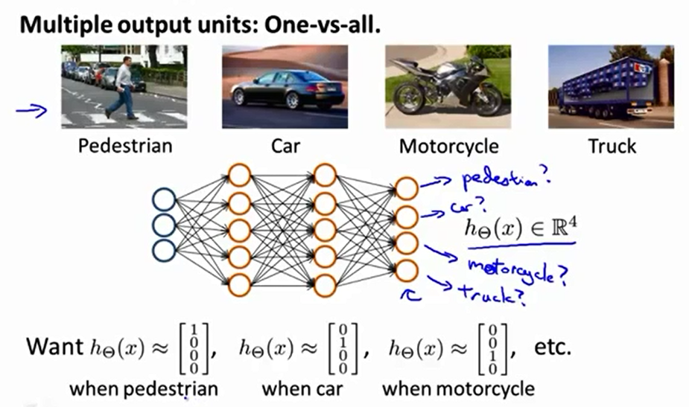

Slide 71
Material Resources
虞台文, Feed-Forward Neural Networks, Course slides presentation
Andrew Ng, Machine Learning, Course slides presentation
MICHAEL NEGNEVITSKY, Artificial Intelligence : A Guide to Intelligent Systems, Second Edition, Addision Wesley, 2005.
Richard O. Duda, et. al, Pattern Classification 2nd Edition, John Wiley & Sons, Inc., 2001
Hung-yi Lee, Deep Learning Tutorial

